Slide 1


Team 30: Smart Pest Repeller
Bi-Weekly Update 4 Andrew Albritton
Michael McNeil
Melquisedec Ordonez Sponsor: Peng Hao Huang TA: Eric Robles
Notes:
Michelle

Slide 2
Problem Statement
Most outdoor areas, whether agricultural, recreational, or communal, require pest control. The two most prominent methods of pest control available to users are pesticides and ultrasonic frequency responses. Pesticides are often highly effective at deterring pests but can be a danger to other flora and fauna in the area. According to the ASPCA, of the 230,000 animals helped in 2019 by their Poison Control Center, around 10-15% suffered from issues related to pesticide exposure. Ultrasonic frequency responses are much safer in this aspect having little effect on the surrounding environment, but effectiveness can be a issue due to the limited frequencies being used, and different pests respond to different frequency ranges.
The goal of the Smart Pest Repeller project is to create a pest control solution that is highly effective like the pesticides solutions used, but does not experience the same environmental drawbacks. This is done by using a ML identification program to identify the types of pests present, then emitting a frequency matched to that pest category.
Notes:
Kyle

Slide 3
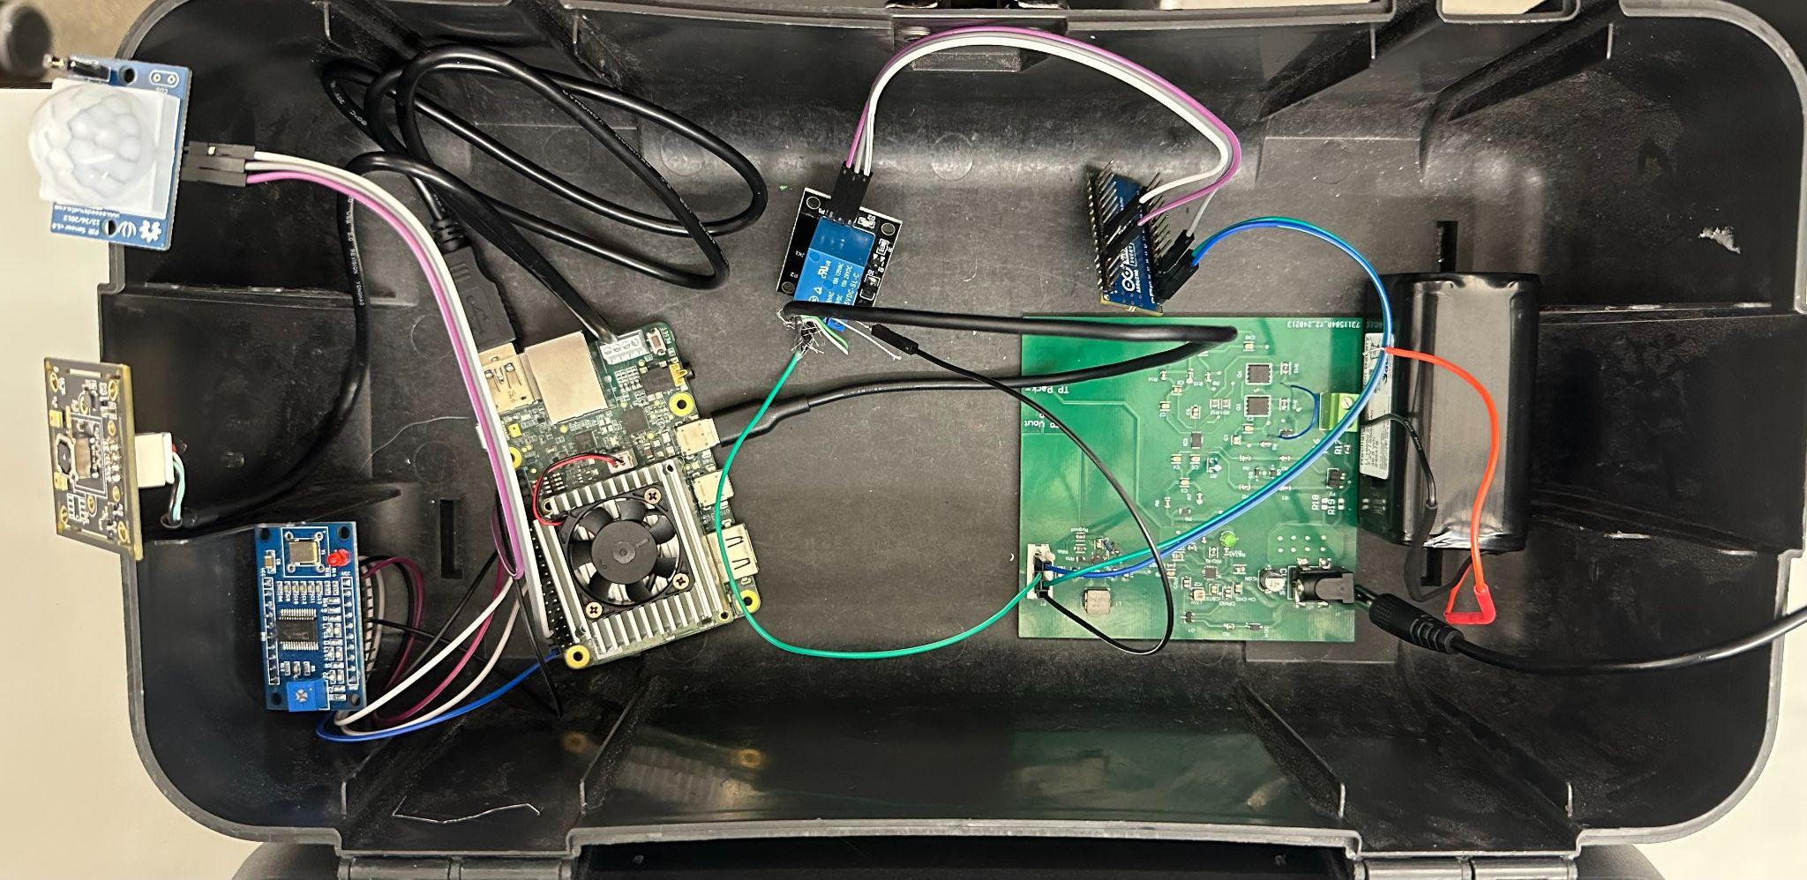
Battery Power Relay Relay MCU Signal Camera Motion
Supply Control Generation Sensor
(on/off switch for users)

Slide 4
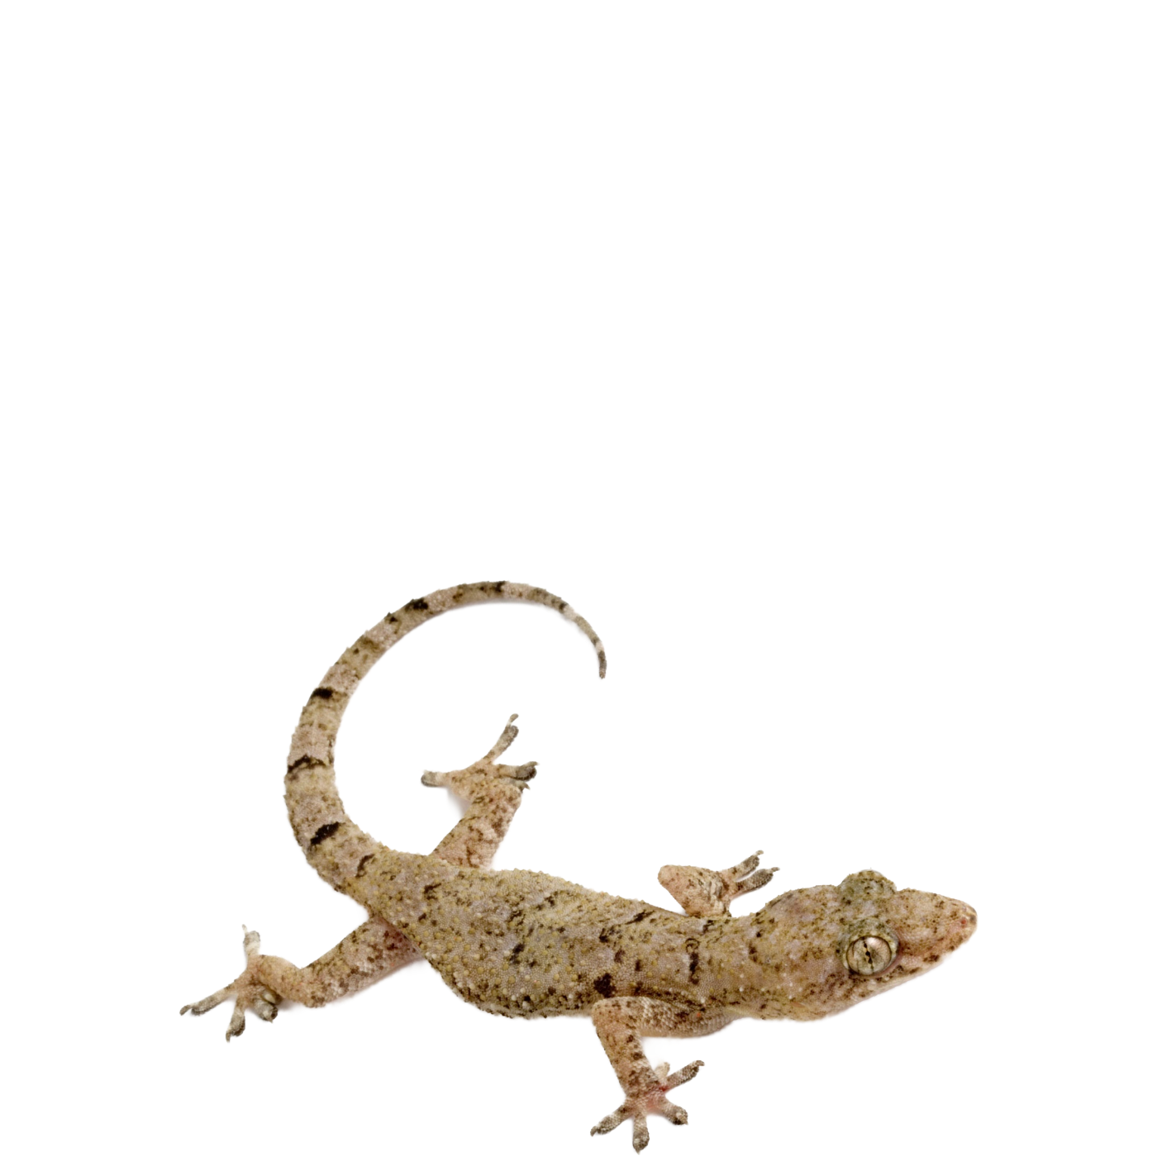
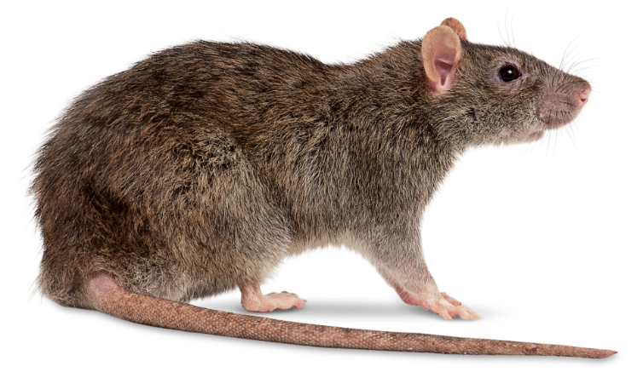

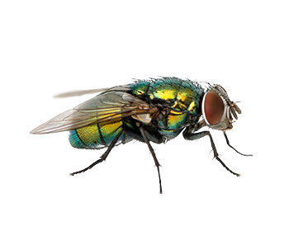
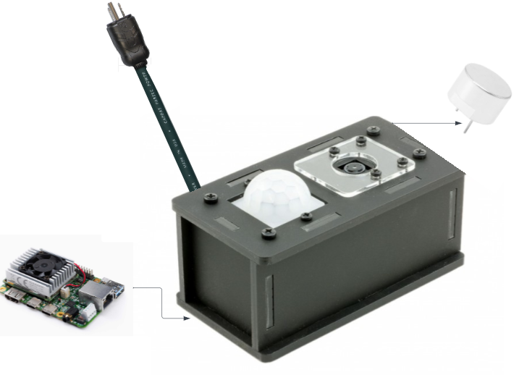
(fleeing animals)

Slide 5
Project Timeline
Subsystem Designs and Testing (was to be completed 3/1, work ongoing) | Integration of power subsystem and MCU (was to be completed 3/17, work ongoing) | Integration of Detection and Emitter System (completed 3/7) | Final Integration (to be completed by 3/23) | System Test (to complete by 4/1) | Validation (to complete by 4/8) | Demo and Report (to complete by 4/15)
Notes:
Eric

Slide 6
Michael McNeil
Accomplishments since last update 45 hrs of effort | Ongoing progress/problems and plans until the next presentation
-Tested and debugged voltage regulator circuit -Load tested PCB | -Address issue with charger being stuck in “fault” state -Ongoing integration and system testing -Work with group on chassis design/production

Slide 7
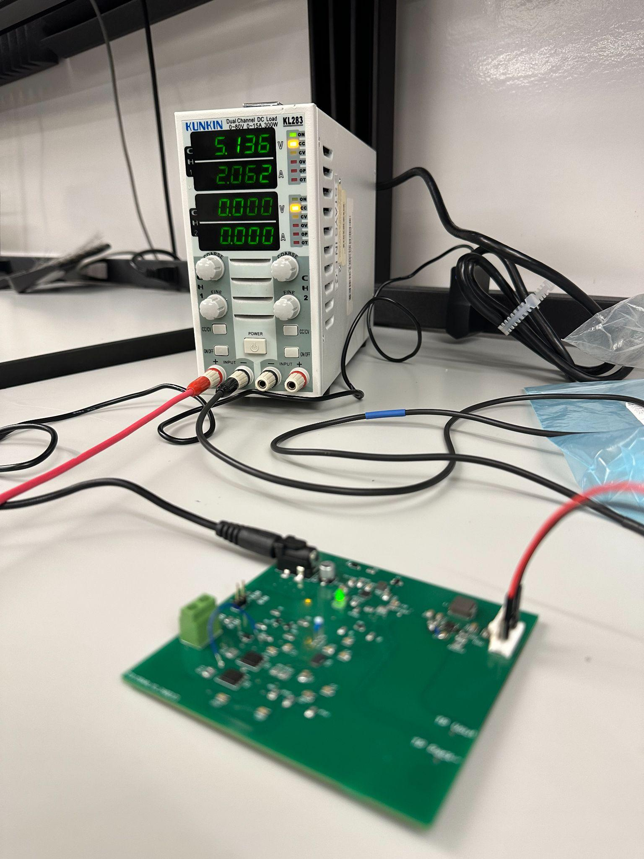
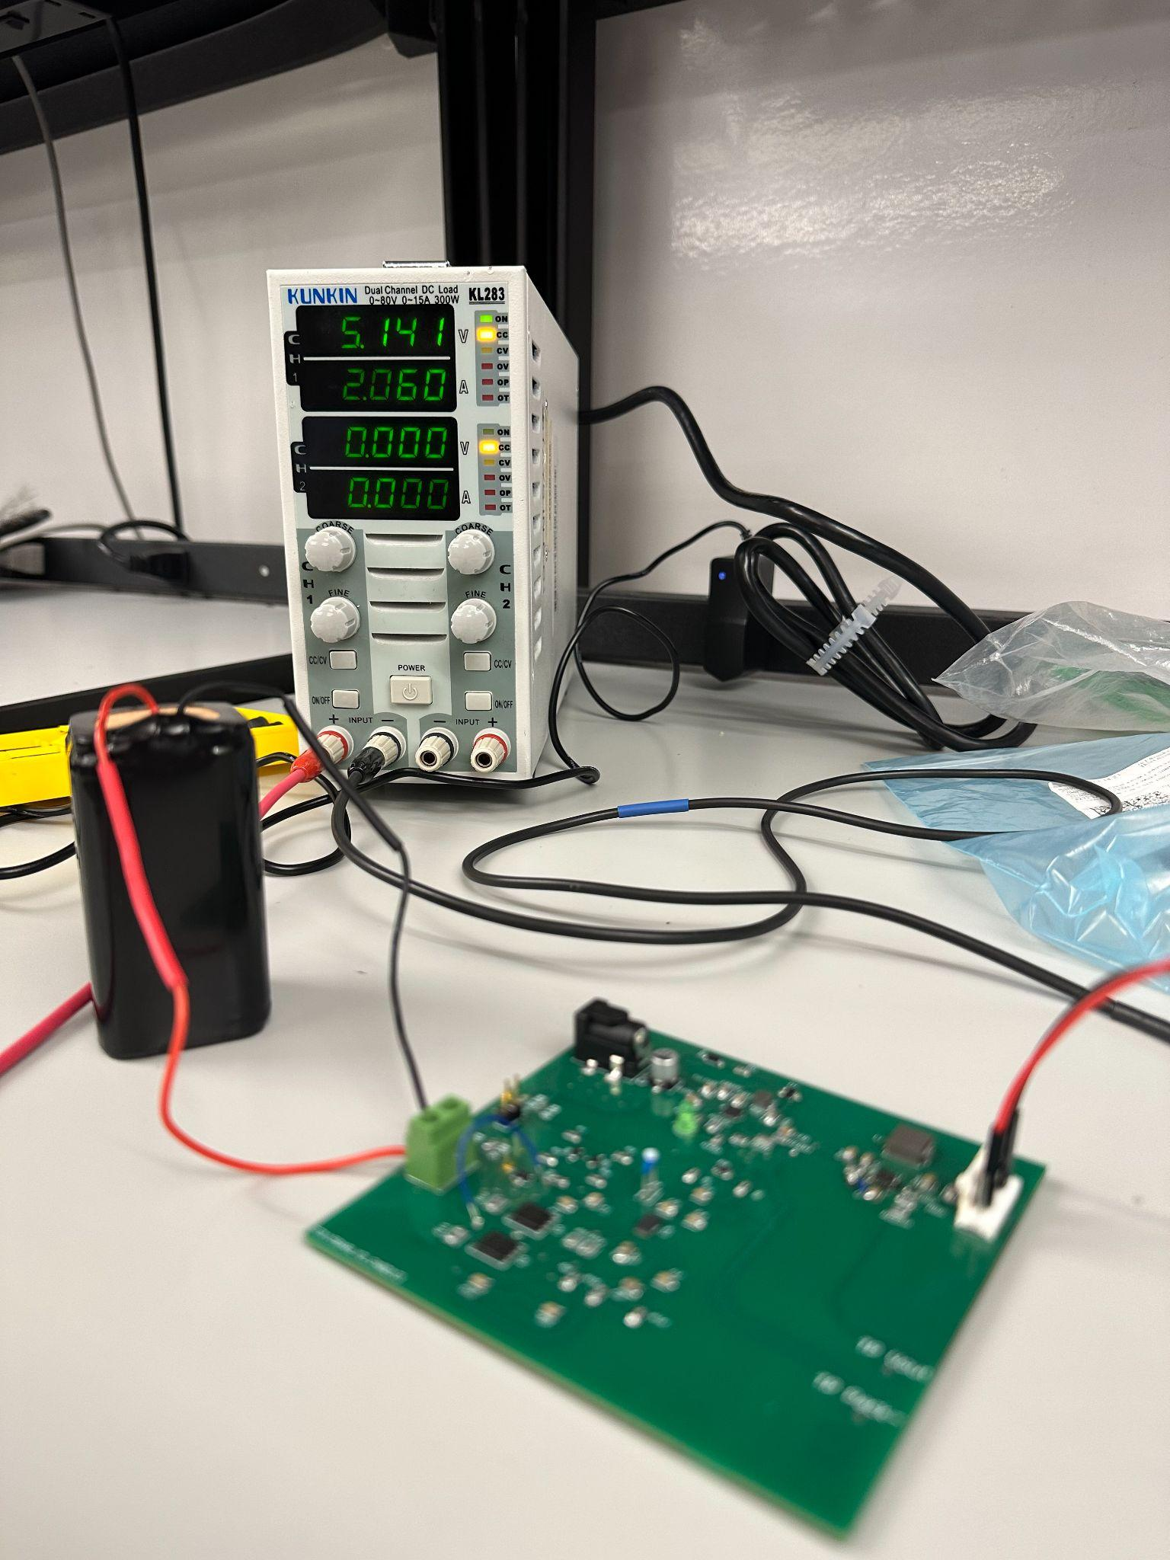
Michael McNeil
Results:
-Load tested under wall and battery power
-Also tested output under various other input voltages between 3V and 16V (voltage range for regulator)

Slide 8
Andrew Albritton
Accomplishments since last update 68 hrs of effort | Ongoing progress/problems and plans until the next presentation
Coral Board run detection on boot Wrote and validated SPI communication with signal generation backup board (SPI will be the same configuration on the designed board as the backup board) Data-set Changed to polygonal boxing | Finish integration with power delivery subsystem Begin testing full integrated system Continue improving model performance Begin designing Smart Pest Repeller chassis.

Slide 9
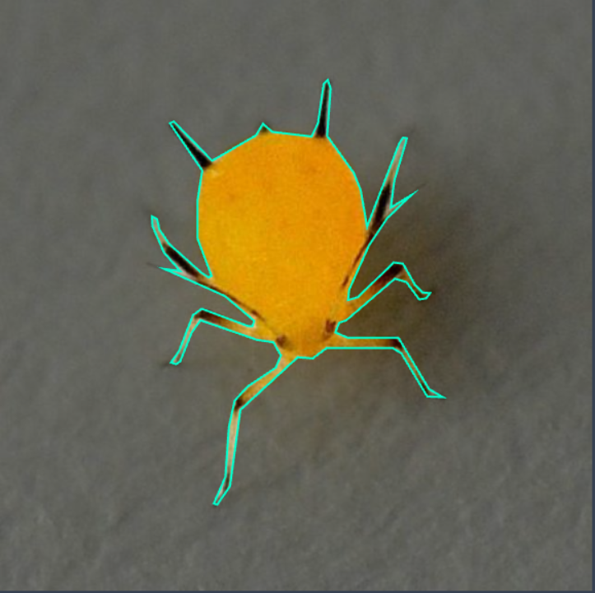
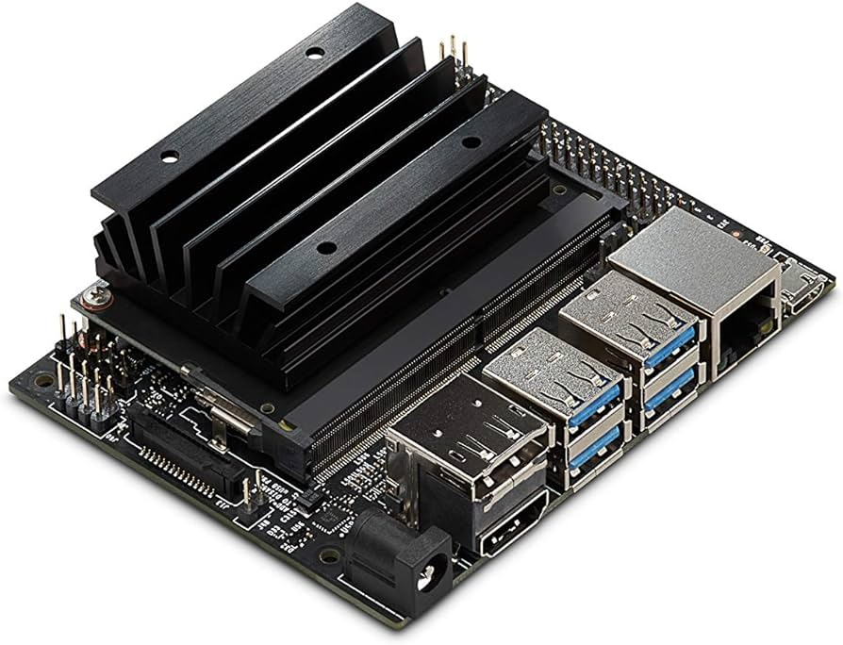

Andrew Albritton

Slide 10
Melquisedec Ordonez
Accomplishments since last update 30 hrs of effort | Ongoing progress/problems and plans until the next presentation
Integration with MCU subsystem complete(3.2.3.2.1 on validation plan) Board assembled | Fix board to fully operational Validate remaining requirements per Validation Plan Implement screen for simple system updates to user.

Slide 11
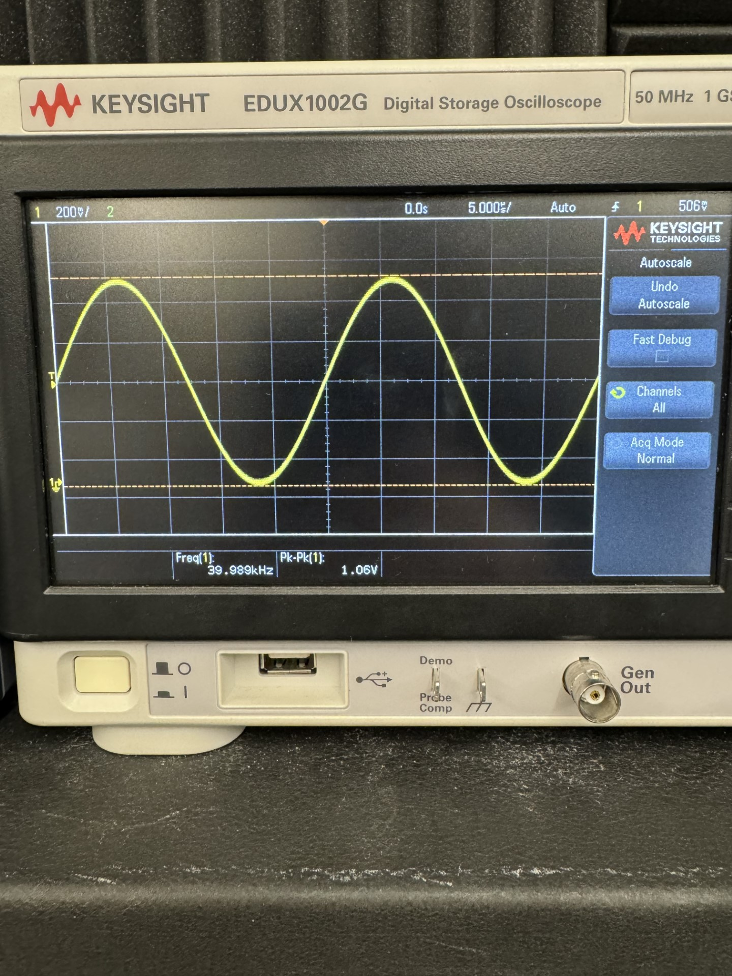
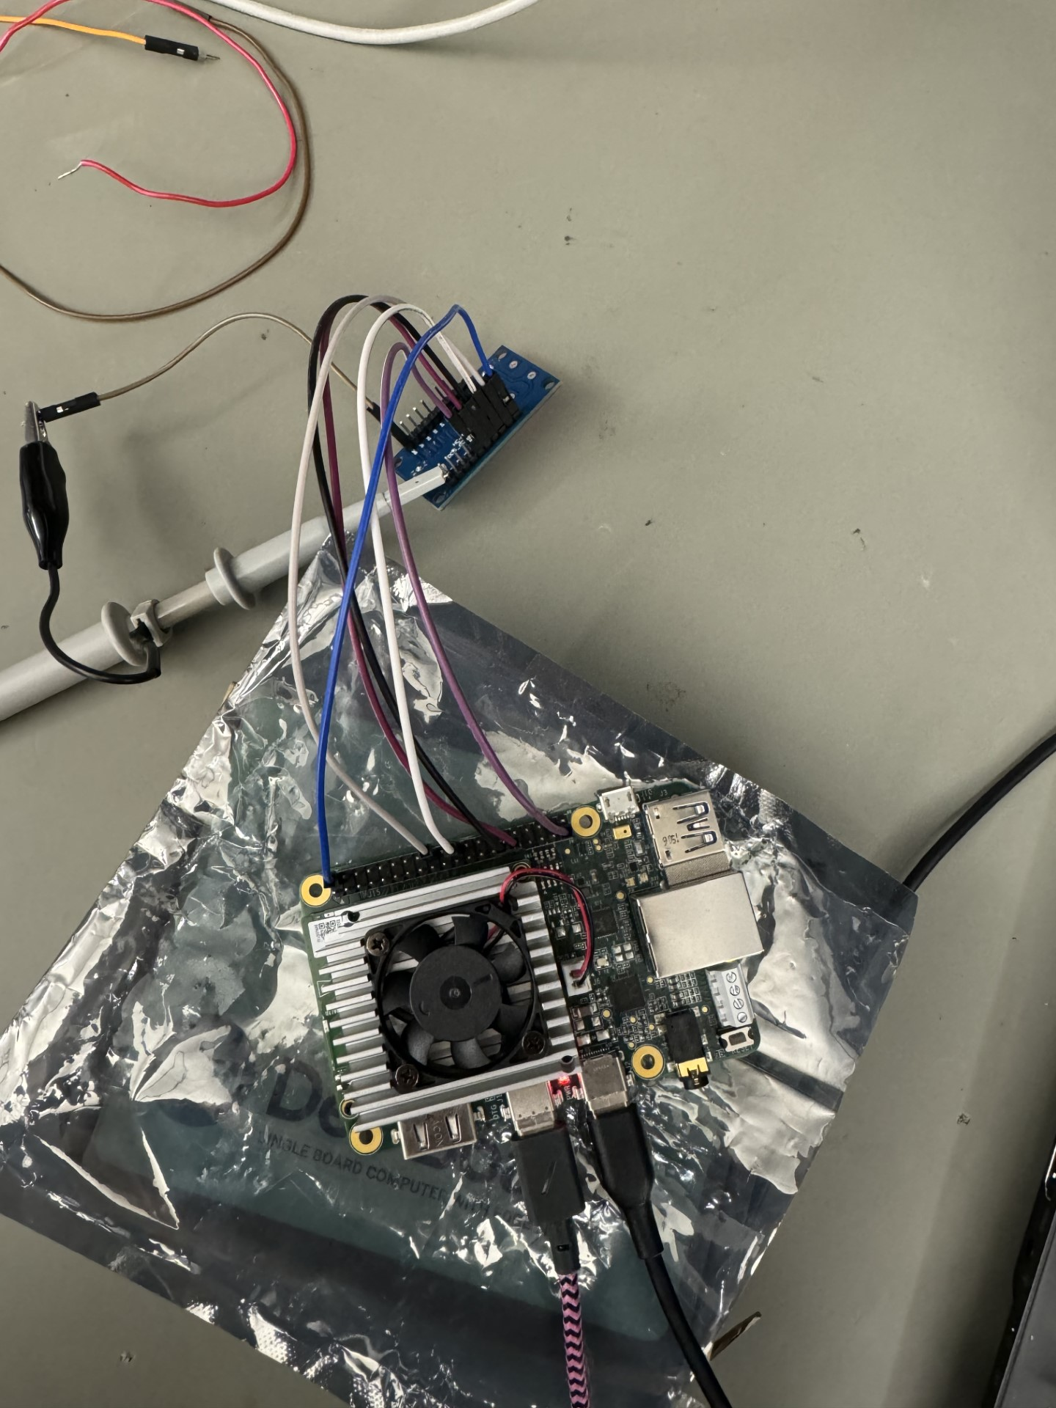
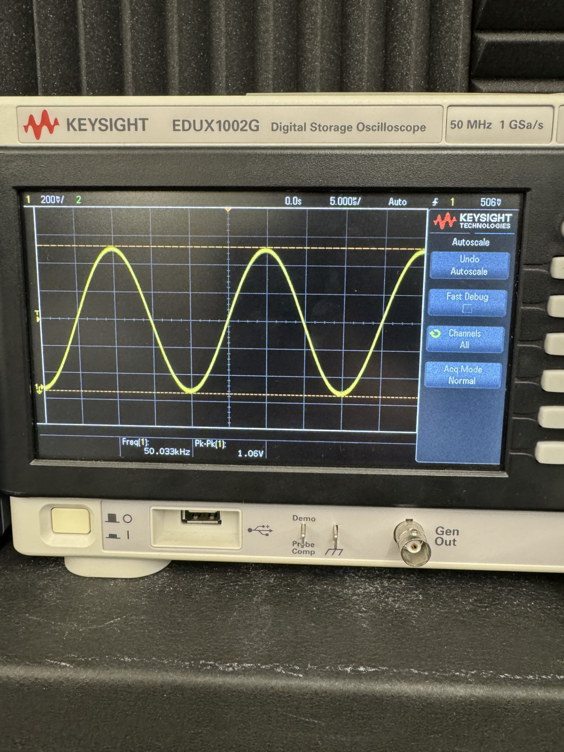
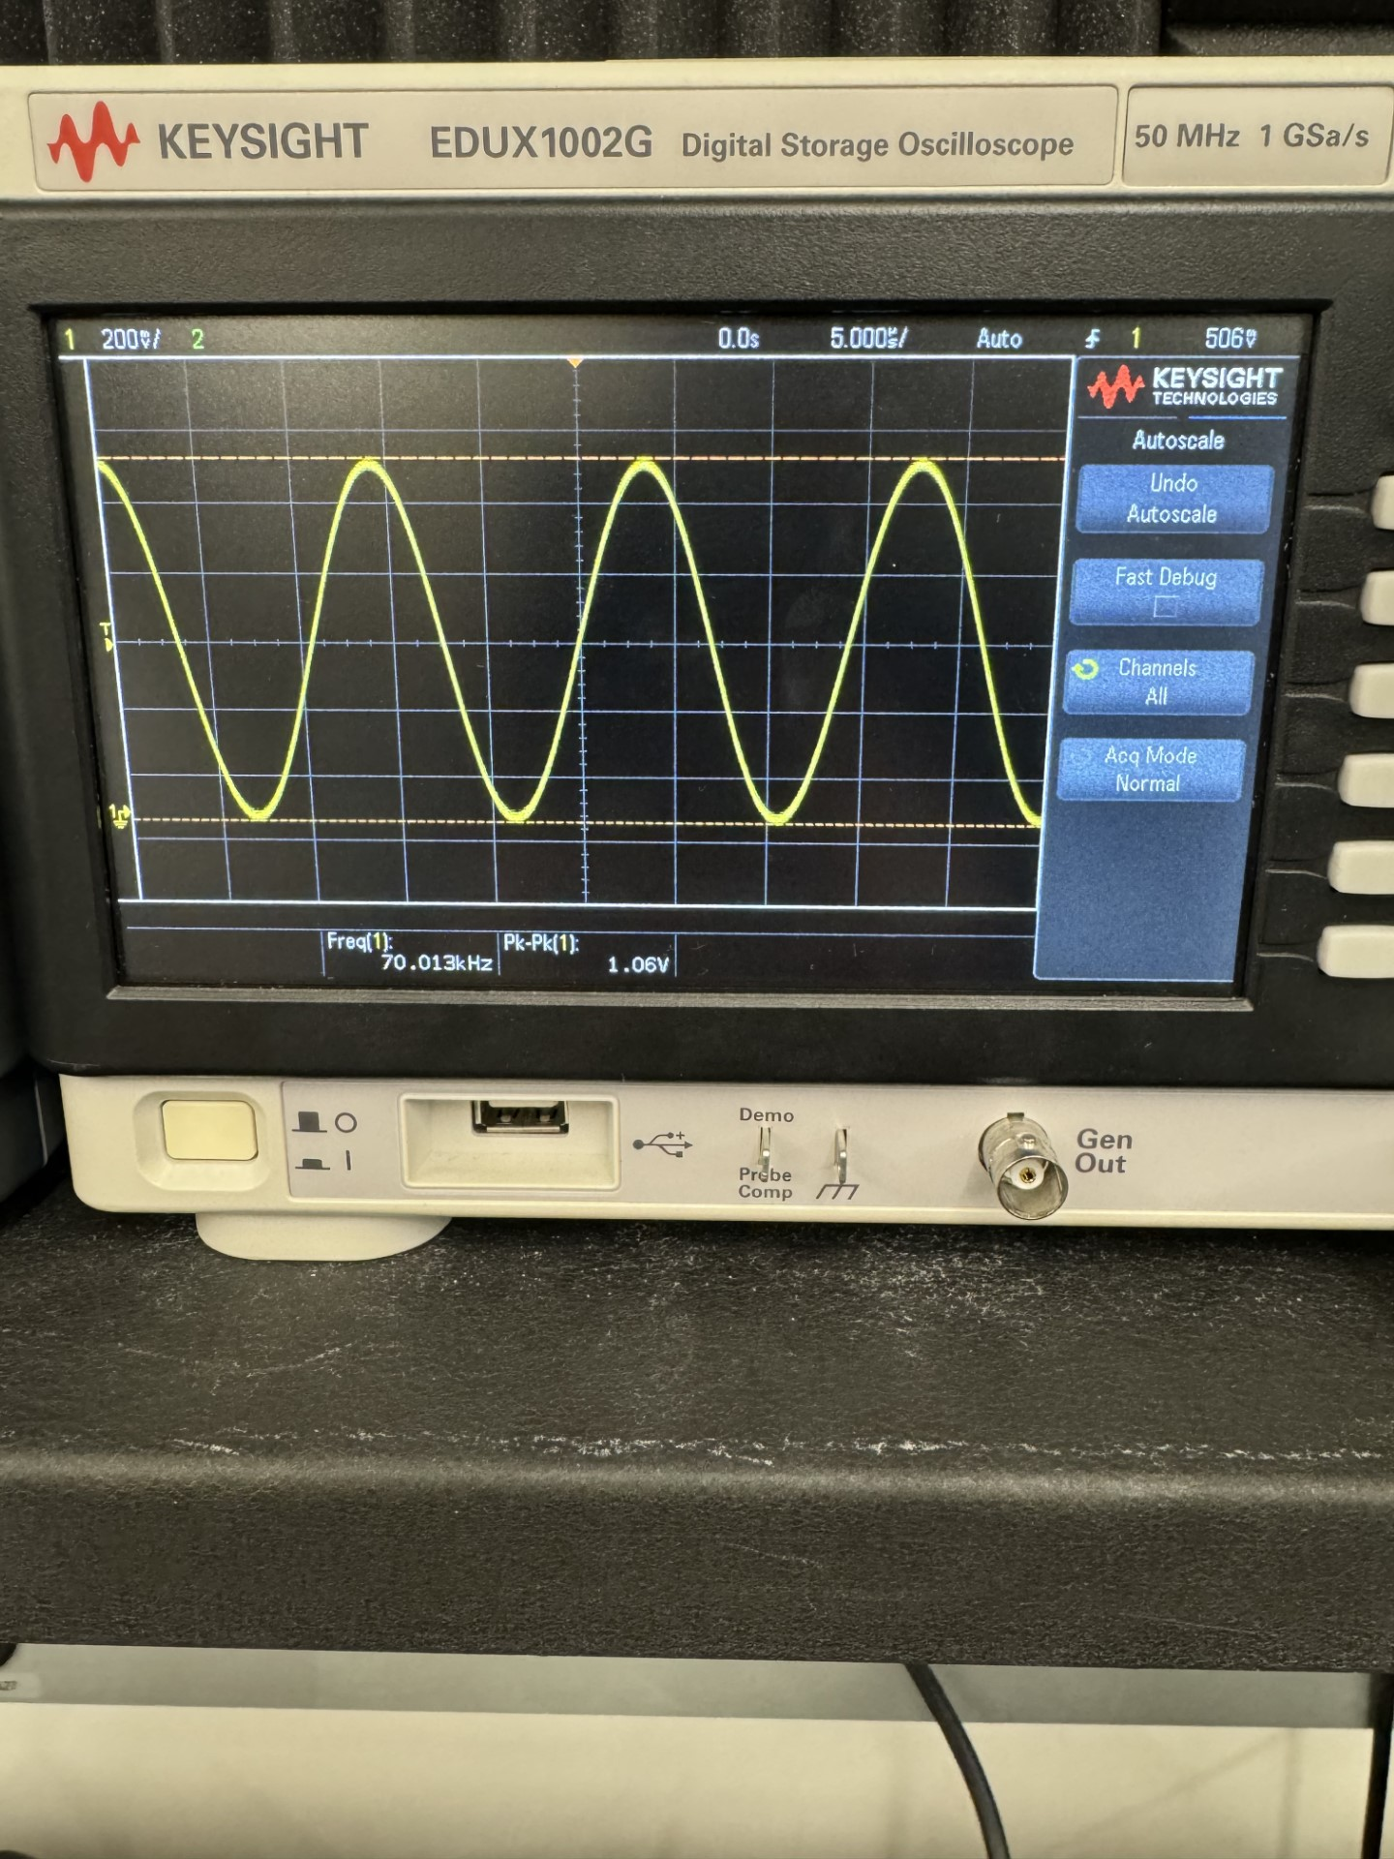
Melquisedec Ordonez
40 KHz
Frequency Generator
50 KHz
70 KHz
MCU

Slide 12
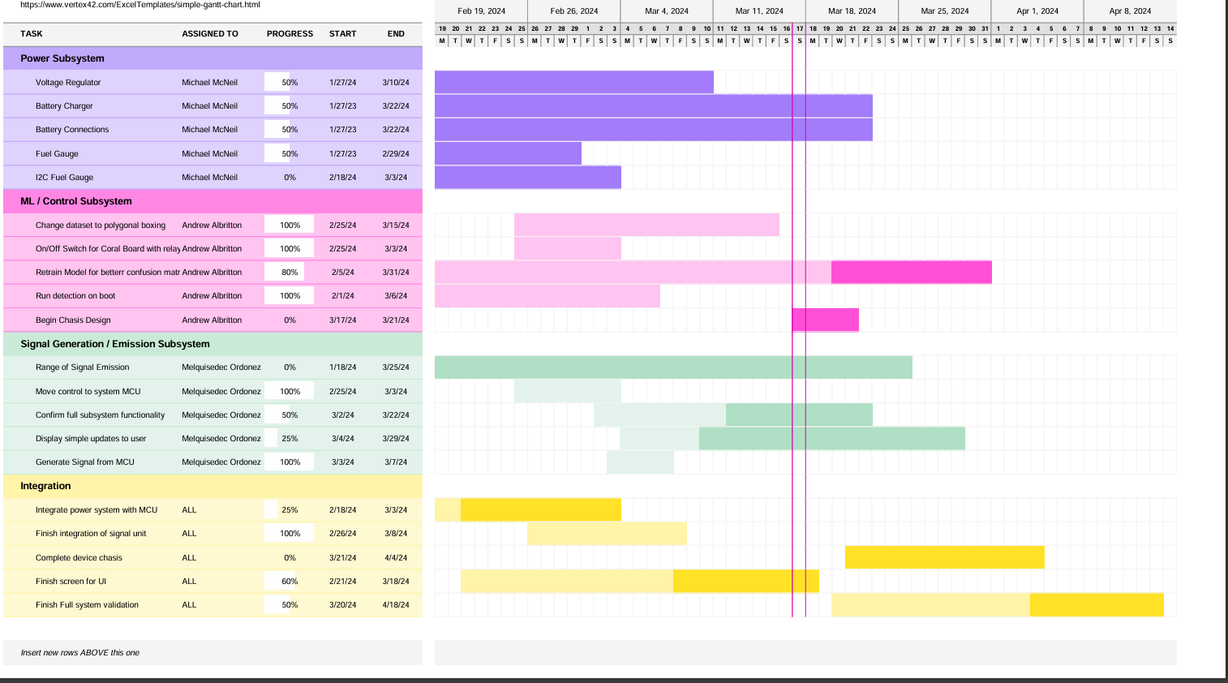
Execution Plan
Notes:
Michelle

Slide 13
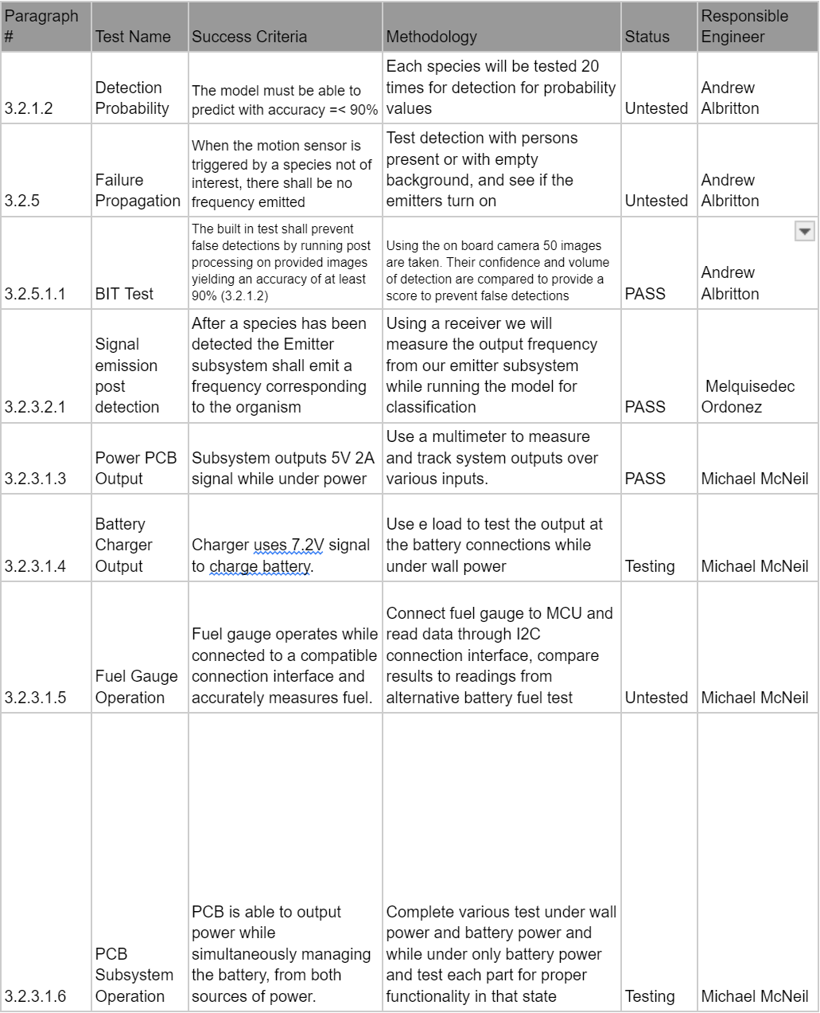
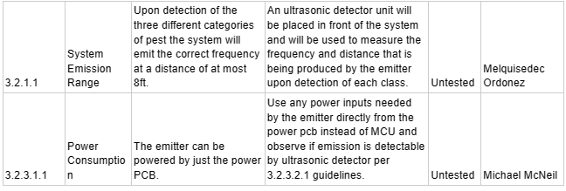
SYSTEM Validation Plan
Notes:
Michelle

Slide 14
Thank you!

